Slide 1

PHASE I ANALYSIS TO ESTIMATE THE IN-CONTROL DISTRIBUTION PARAMETERS

Slide 2
AIM:
The aim of the project is to perform a Phase I analysis for the given set of simulated data observations containing 1000 observations over 25 quality characteristics.
Phase I analysis is a kind of Statistical Process Control (SPC) which is applied to set of historical data that are both in-control and out-of-control.
Our main aim here is to remove the out of control points in the given data and plot the rest of the data on the re-calculated control parameters.
This process is repeated until all the data is inside control limits.
Methodology followed:
Step 1: Principal Component Analysis is done and univariate charts are plotted on the uncorrelated univariate charts to detect and remove the out of control points.
Step 2: Out of control points are cumulatively removed using the Hotelling T² control chart on the data which has points removed in step 1.
Step 3: After removing the points using the first 2 steps, the m-CUSUM chart is used to detect the small mean shifts ( considered 3 different offset values(k) to detect and remove different levels of mean shifts).
[SOFTWARES USED: Matlab and R]

Slide 3
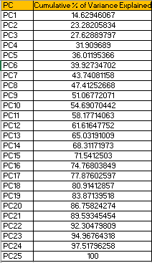
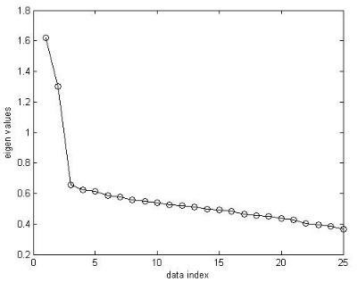
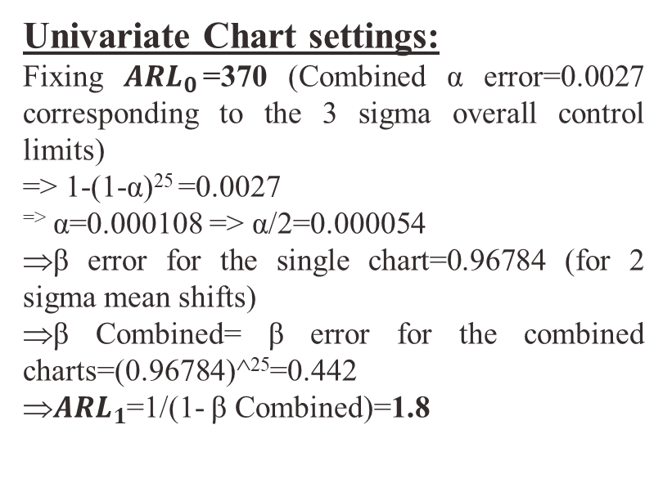
STEP 1:
After performing the PCA, it was found that all the 25 components are important as the scree plot (plot of λ vs i) did not showing any elbow bend and the 85% variance of the data was explained by using 20 PCs and hence there is not much use of dimension reduction.
Hence the 25 PCs were still used and the dimension of the data is not reduced for the purpose of de-correlating the variables and hence facilitating the use of the control charts to detect the out of control points.
Univariate Chart settings:
Fixing ${ARL}_{0}$=370 (Combined α error=0.0027 corresponding to the 3 sigma overall control limits)
=> 1-(1-α)²⁵ =0.0027
^{=>} α=0.000108 => α/2=0.000054
β error for the single chart=0.96784 (for 2 sigma mean shifts)
β Combined= β error for the combined charts=(0.96784)^²⁵=0.442
${ARL}_{1}$=1/(1- β Combined)=1.8

Slide 4
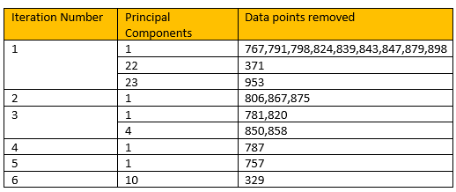
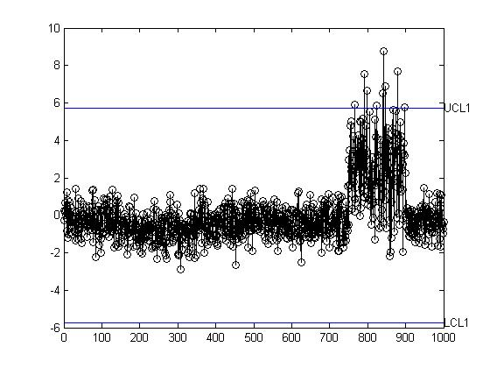
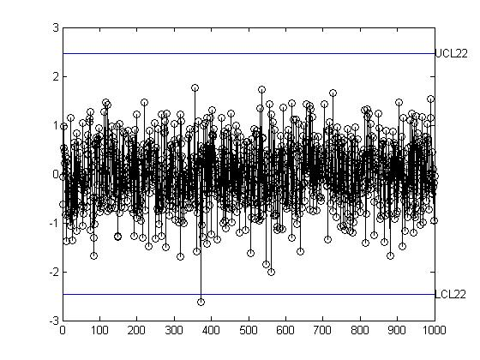
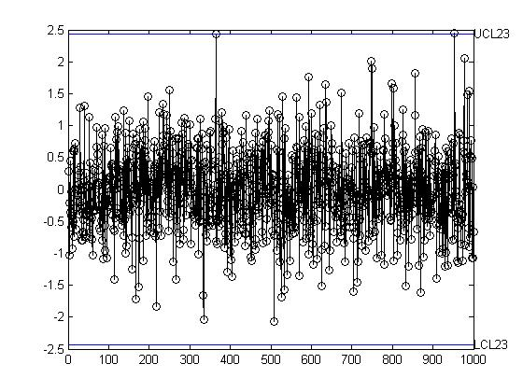
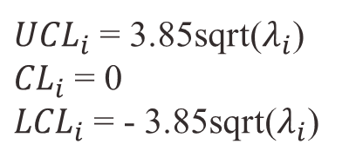
${UCL}_{i}$ = 3.85sqrt($λ_{i}$)
${CL}_{i}$ = 0
${LCL}_{i}$ = - 3.85sqrt($λ_{i}$)
PLOTS OF UNIVARIATE PC CHARTS THAT HAD OUT OF CONTROL POINTS (BEFORE REMOVING THEM)
Iteration 1(${PC}_{1}$) Iteration 1(${PC}_{22}$) Iteration 1(${PC}_{23}$)

Slide 5
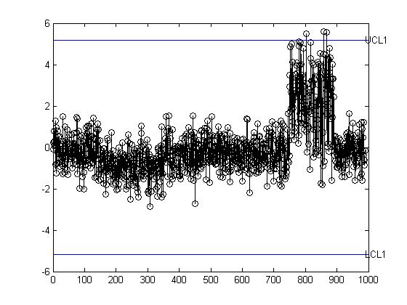
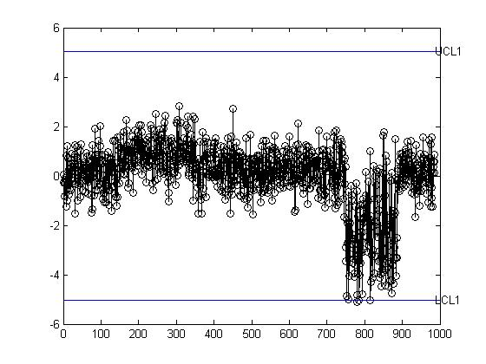
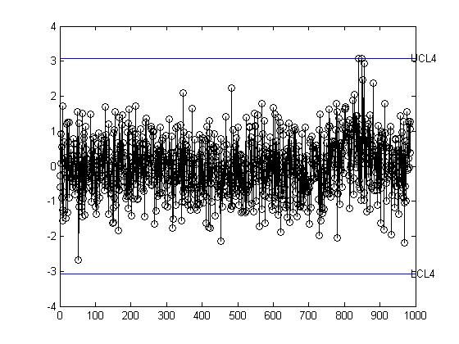
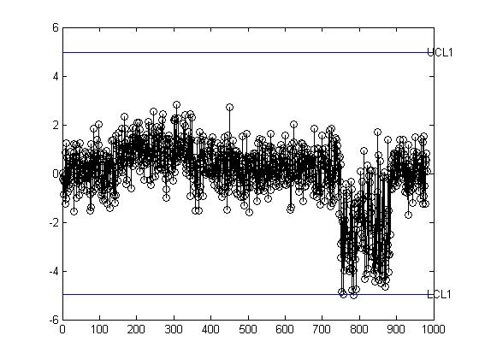
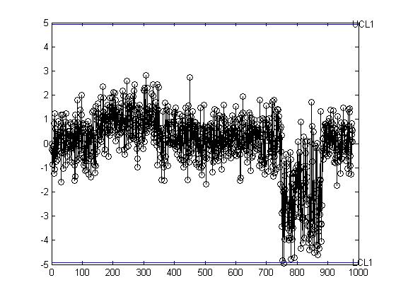
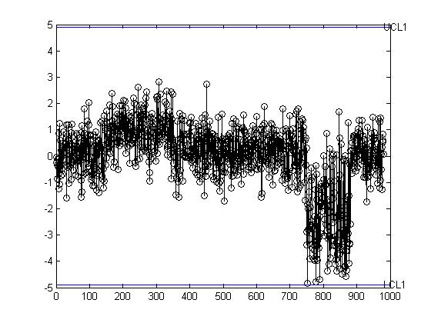
Iteration 2(${PC}_{1}$) Iteration 3(${PC}_{1})$Iteration 3(${PC}_{1}$)
Iteration 4(${PC}_{1}$) Iteration 5(${PC}_{1}$) Iteration 6(${PC}_{1}$)

Slide 6
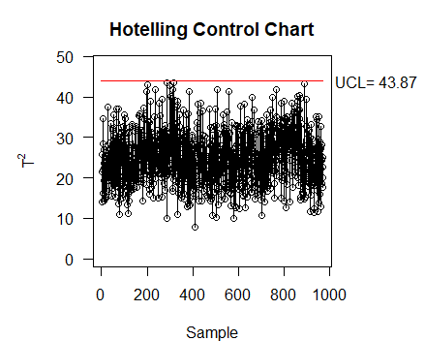

PLOT AFTER REMOVING OUT OF CONTROL POINTS
Step 2:
After the PCA charts, the Hotelling T² chart is used next to mainly capture the large spikes in the data, remove the out-of-control points and iterate till all the out-of-control points are removed.

Slide 7
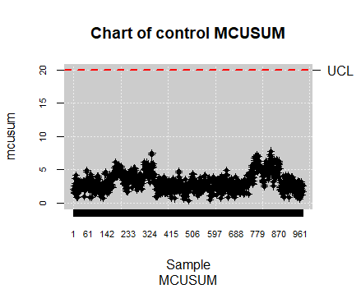
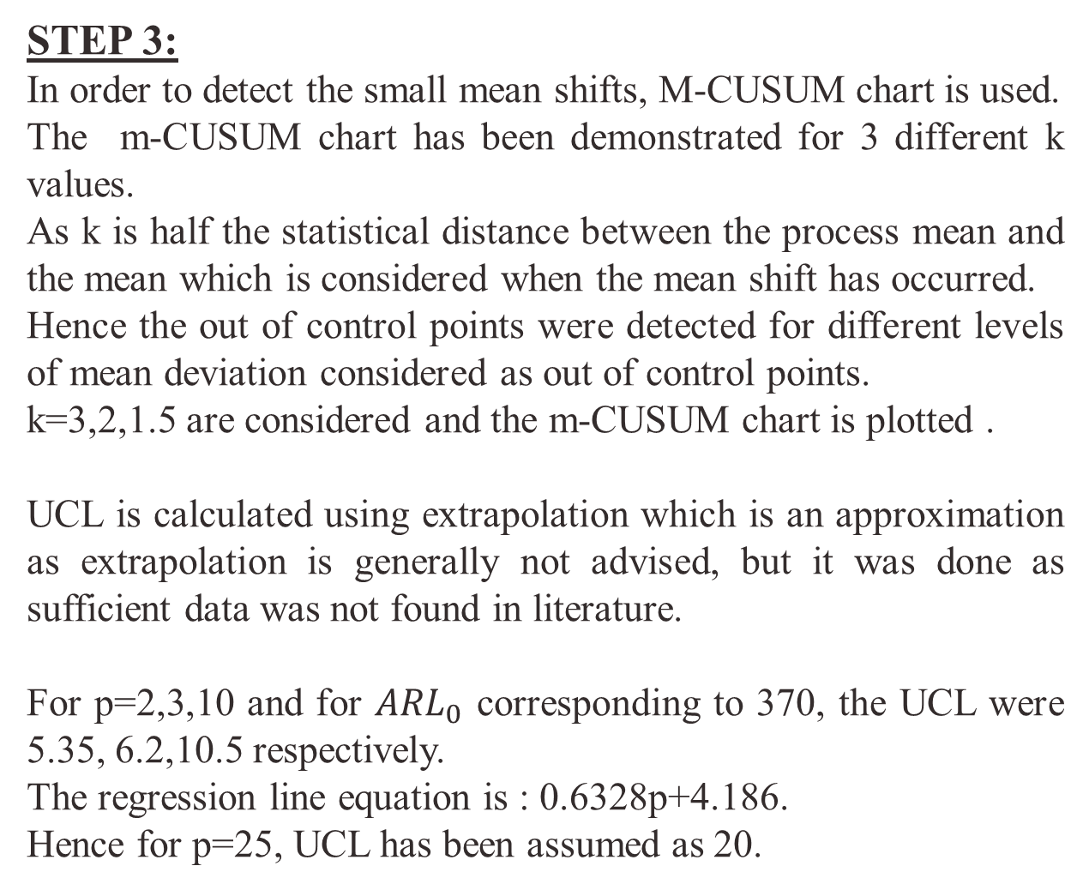
STEP 3:
In order to detect the small mean shifts, M-CUSUM chart is used.
The m-CUSUM chart has been demonstrated for 3 different k values.
As k is half the statistical distance between the process mean and the mean which is considered when the mean shift has occurred.
Hence the out of control points were detected for different levels of mean deviation considered as out of control points.
k=3,2,1.5 are considered and the m-CUSUM chart is plotted .
UCL is calculated using extrapolation which is an approximation as extrapolation is generally not advised, but it was done as sufficient data was not found in literature.
For p=2,3,10 and for ${ARL}_{0}$ corresponding to 370, the UCL were 5.35, 6.2,10.5 respectively.
The regression line equation is : 0.6328p+4.186.
Hence for p=25, UCL has been assumed as 20.
K=3
No out of control points were detected
for k=3.

Slide 8

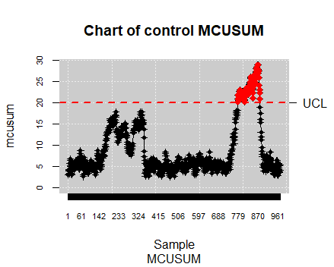
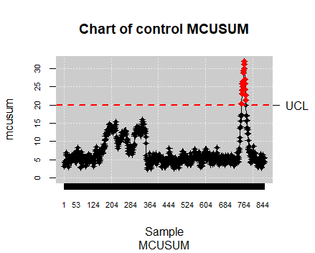
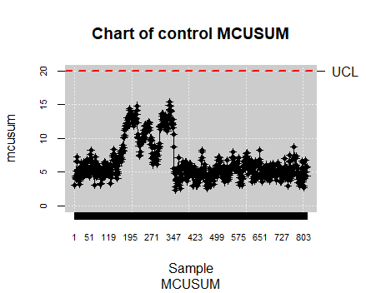
For K=2,
Initial plot after the first 2 steps After Iteration 1 After Iteration 2

Slide 9
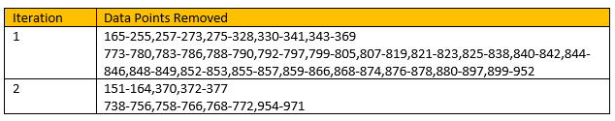
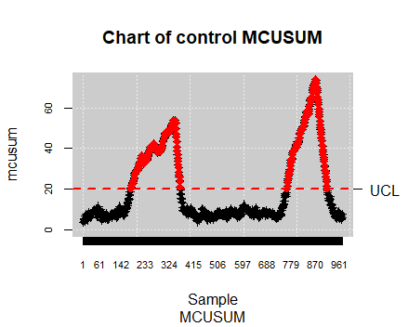
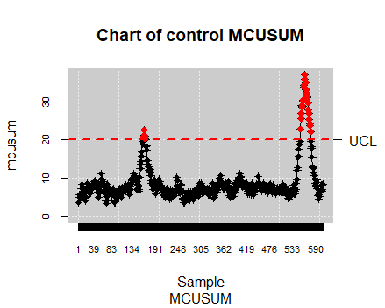
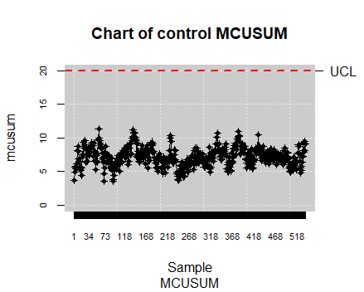
For K=1.5
Initial plot after the first 2 steps After Iteration 1 After Iteration 2

Slide 10
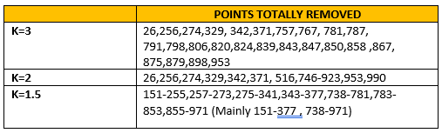
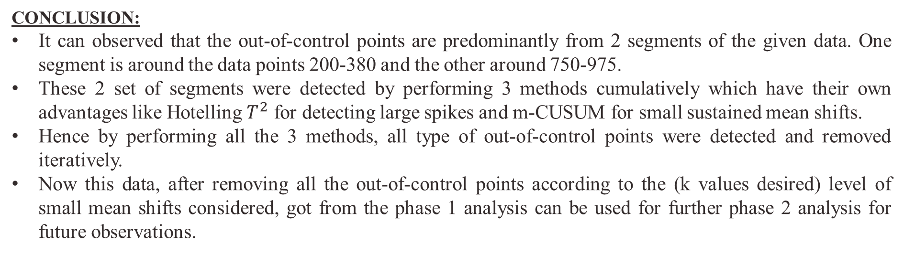
RESULT:
FINAL set of points removed by steps 1(PCA), 2(Hotelling $T^{2}$ chart) and 3(m-CUSUM for 3 different k values):
CONCLUSION:
It can observed that the out-of-control points are predominantly from 2 segments of the given data. One segment is around the data points 200-380 and the other around 750-975.
These 2 set of segments were detected by performing 3 methods cumulatively which have their own advantages like Hotelling $T^{2}$ for detecting large spikes and m-CUSUM for small sustained mean shifts.
Hence by performing all the 3 methods, all type of out-of-control points were detected and removed iteratively.
Now this data, after removing all the out-of-control points according to the (k values desired) level of small mean shifts considered, got from the phase 1 analysis can be used for further phase 2 analysis for future observations.

